Slide 1

PREDICTIVE MODEL – CAR INSURANCE CLAIM PROBABILITY (BASED ON COMPREHENSIVE CAR POLICY FEATURES AND SAFETY RATINGS)

Slide 2
Problem Statement
Develop a predictive model that assesses the claim probability for car insurance policies. The objective would be to understand the factors that influence claim frequency and severity in the period of six months and enable insurance companies to better assess risk and determine appropriate premiums for policyholders.

Slide 3
Data Structure
Number of columns – 44
Number of Numerical columns – 17
Number of Categorical columns – 27
Number of Rows – 58592

Slide 4
Steps followed to build a Predictive Model
Importing required libraries & the data
Separate the dataset into input (independent features) & output data (dependent feature)
Data Pre-processing (includes data cleaning, removing duplicate values, Outlier handling)
Dividing the data set into training and testing data
Removing Data Imbalance issue (if exists)
Model building
Comparing different models based on evaluation metrics to select the most suitable model.
Extracting out important features defining the features having maximum impact on predicting the output.

Slide 5
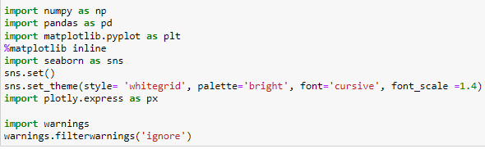

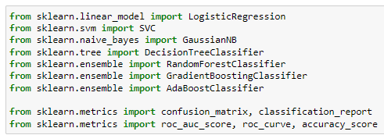
Libraries used in the Project

Slide 6
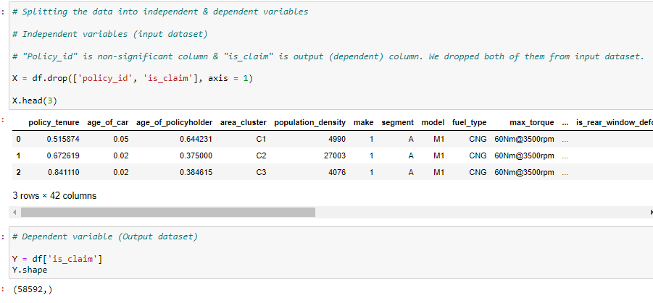
Imported dataset and separated input & output columns
We dropped “policy_id” being just an independent ID of policy and having no effect on output.
We dropped ‘is_claim’ column, being the dependent variable to be predicted.

Slide 7

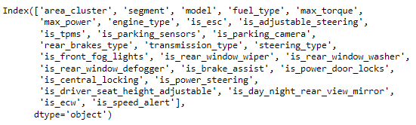
Numerical Columns in our input dataset - 15
Categorical Columns in our input dataset - 27

Slide 8
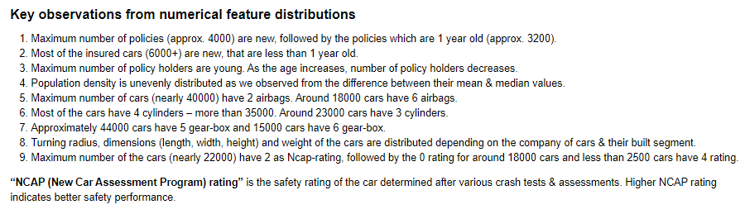
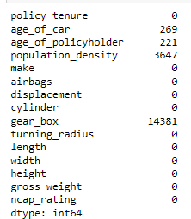
Observations about Numerical columns after Distribution Plot
Total number of outliers in each numerical column

Slide 9
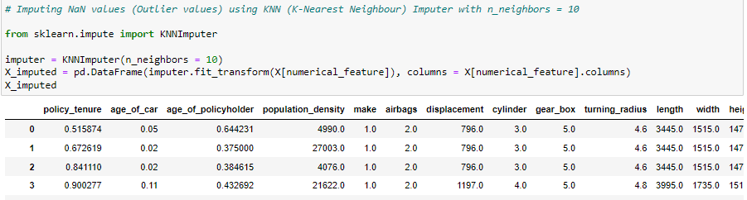
We used “KNN Imputer” method to deal with outliers. This involves 2 steps -
1. Converting Outliers into NaN values.
2. Replacing NaN values using KNN method with n-neighbors = 10 is considered.

Slide 10
Further EDA observations –
We did Pearson’s correlation analysis, & found out that “Multicollinearity” does not exist within numerical columns.
For categorical columns, we performed “Chi-square” test to determine if an input column has significant relationship with output column, based on p-value.
We have an option to drop those categorical columns from input dataset, which have no significant relationship with output variable.
But we will not drop them, considering that they may not have significant impact, but must be having some effect on dependent variable depending on "how high the p value is from 0.05", so dropping such columns is not recommended.
We performed feature scaling (Standardization) on input numerical columns to bring all features to same scale and One Hot Encoding method to convert categorical columns into numerical data for model building, together using “Column Transformer” entire input column into numerical data values.
We observed that, there is high class imbalance in our dependent features (output data).
We built models firstly without taking care of data imbalance issue, and then after dealing with data imbalance issues using SMOTE (Synthetic Minority Oversampling Technique), in order to understand the impact of data imbalance.

Slide 11
Different Model’ Performance
We have data imbalance in out dataset, so we can’t rely on accuracy of the model, & we will consider other metrics for model evaluation, such as F1–score, Precision, Recall & Roc-auc-score (defines if it’s a good/ bad model).
If roc-score < 50%, it’s “BAD Model”, if it’s > 50% , it’s “GOOD model”, and if it’s = 50%, its “on borderline”.
Roc score - BEFORE fixing Class Imbalance
Roc score - AFTER up-sampling minority class using SMOTE Technique
Logistic Regression – 0.5
Support Vector Classifier – 0.5
Naïve Bayes – 0.52
Decision Tree Classifier – 0.503
Random Forest Classifier – 0.5
Gradient Boosting – 0.49
Ada Boosting – 0.5
Logistic Regression – 0.55
Support Vector Classifier – 0.5
Naïve Bayes – 0.5
Decision Tree Classifier – 0.51
Random Forest Classifier – 0.60 (at max depth = 6)
Gradient Boosting – 0.56
Ada Boosting – 0.57

Slide 12
Key Model evaluation process observations –
Generally, tree based models do not get impacted from imbalanced data set, but in our case, we did not find a satisfactory roc-score to consider as a final model.
Before dealing with class imbalance issue, almost all models gave high accuracies and border line roc-scores respectively. Therefore, none of them considered.
While using SMOTE technique, we tried out different distributions ratio of minority to majority class, to control the up-sampling of minority class.
Different set of distributions considered are –
100-100% (default up-sampling distribution of majority & minority classes),
100% (majority) – 80 % (minority)
100% (majority) – 70 % (minority)
100% (majority) – 60 % (minority)
We got values of different model’s roc-score along with other metrics in classification report.
Based on different values, we observed that in almost all the models, as the minority class distribution decreased, “roc-score” of the model also decreased.
The best model roc-score we observed is “Random Forest Classifier”, with a roc-score is 60, calculated at max depth of 6.

Slide 13
Effects of “Data Imbalance” on Model’s performance
1. Skewed Class Distribution - In case of dataset imbalance, the minority class is significantly underrepresented compared to the majority class in a classification problem. This can skew the model’s learning process leading to poor performance on the minority class.
2. Biased Model Training - In imbalanced datasets, a model achieves high accuracy by simply predicting the majority class for all instances, ignoring the minority class completely. As a result, the model is biased towards the majority class & fails to capture patterns in the minority class accurately.
3. Poor Generalization - Since the model hasn’t learned enough about the minority class due to its scarcity in the training data, it may struggle to make accurate predictions for instances belonging to that class in real-world scenarios.
4. Evaluation Metrics Misleading - Traditional evaluation metrics like "accuracy" can be misleading in imbalanced datasets, since a model achieving high accuracy may perform poorly on the minority class, which is often the class of interest. Using metrics like "precision, recall, F1-score, or area under the ROC curve (AUC-ROC)" can provide a better understanding of the model’s performance across different classes.

Slide 14
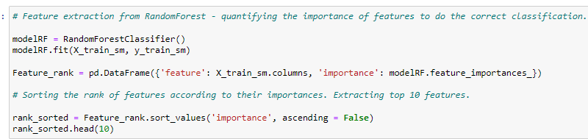
Defining importance of independent features
We extracted out important features using “Random Forest Classifier” by fitting the model on up-sampled training dataset.
Then we used sorting feature to sort the features based on their ranks in ascending order.

Slide 15
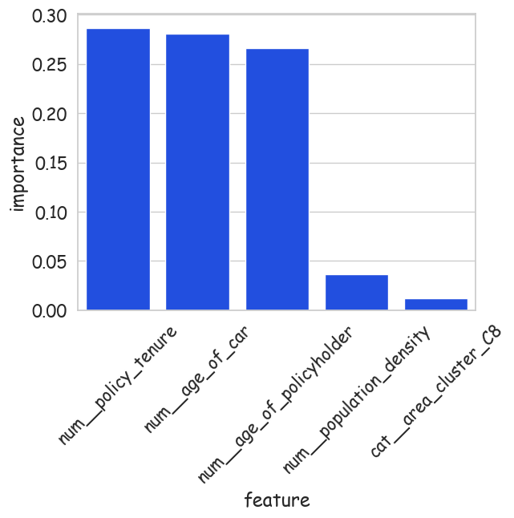
Top 5 independent features with highest importance
1. These are the features, that will highly affect the probability of person claiming a car insurance.
2. In order to predict if a person will get his insurance claimed or not, company must focus on these features.

